Slide 1
Meeting 2/27
SPRING BREAK COUNT DOWN:
5 Days!!

Slide 2
Relay for Life
March 24-25th
Walter Fieldhouse 6pm-3am
Costs $10
Theme: Las Vegas
(Wedding with Photo Booth)

Slide 3
Uni
Money will be due:
March 20th
Rented and New

Slide 4
Attendance
It’s important!!!!!
Novice:
-1st miss-5k
-2nd miss-10k
-3rd miss-15k
*no call no show, unexcused

Slide 5
Elections
Nominations: March 20th
Elections: March 27th

Slide 6
Spring Break Guidelines

Slide 7
Food!!
Carly’s House Dinner:
https://docs.google.com/spreadsheets/d/1s9ucM-Gr2EArVIP1UV8srFqt9ODZ0KCP4IUEPqDmtT4/edit?usp=sharing
“Don’t eat food that will make
you vomit the next day.” – Carl

Slide 8
Food Spring Break:

Slide 9
Travel Pack!
This will be us!

Slide 10
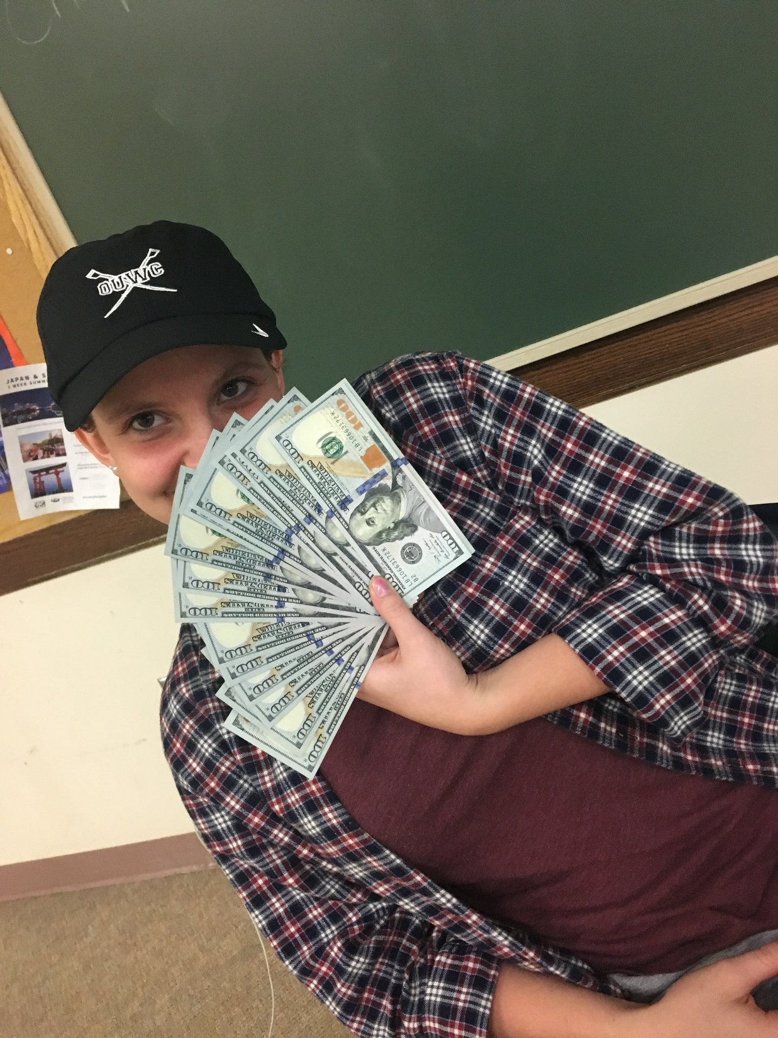
First Camp Payment
Money to Jeannie
Checks made out to Ohio University Women’s Crew
If you get an envelope PLZ label it with your name, the amount,
how you paid (cash or check with the check number) and
the word CAMP
IF YOU HAVE ERG-O-THON MONEY GIVE IT TO CHEY I DON’T WANT IT (yet) !!!*!**!*!*!*!*!*!!

