Slide 1
OUSFIMG FAC Presentation Spring 2021

Slide 2
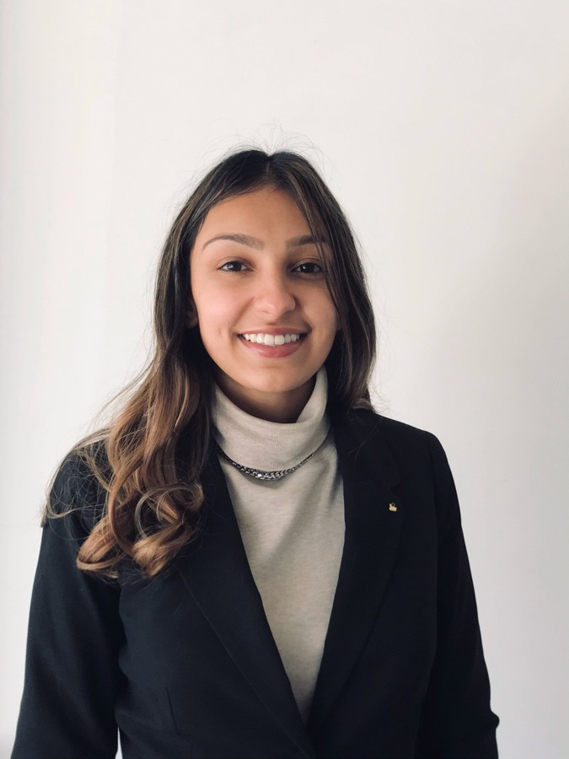
Introductions
Abe Dalisky
President
Simar Kalkat
Quantitative Strategies
Notes:
Name, position, major,

Slide 3
Semester in Review
Portfolio
2020 Year in Review
Performance & Past Strategies
Market Outlook & Current Strategies
Team Dynamics
Fall & Spring Recruitment
Managing Expectations & Culture
Trainings & New Member Onboarding
Accomplishments

Slide 4
2020 Year in Review
Jan-Feb: All-time low credit spreads
Mar-Apr: Liquidity concerns
May-Jun: Effects of Fed intervention
Jul-Aug: Continued tightening of spreads
Sep-Oct: Climb in cases
Nov-Dec: Positive vaccine news
Notes:
LUACOAS started at 96bps and ended at 96bps

Slide 5
Traditional Port | Past Strategy
Strategy going into Fall 2020 / 2021
Underweight duration
Attempt increase cautiously
Increase effective corporate exposure
Swap out of long-term treasuries
Increase MBS allocation
Add 200K to the portfolios
Corporate Securities Purchased 2021 | Purchase Date
Apple 2050 | Jan. 22nd
Bank of America 2051 | Jan. 22nd
Comcast 2030 | Feb. 22nd
Barclays 2024 - Floater | Mar. 8th
Alibaba 2027 | Mar. 30th
Notes:
Have stat for what % we are underweight duration for alumni
Small but sizable, *net of Fees joke on outperformance by 3bps, most importantly better in terms of risk management perspective than we had during the COVID-induced liquidity crisis

Slide 6
Performance Metrics YTD| Traditional
Total Return (%) |  |  |  |  | YTD | 1mo | 3mo | 6mo | 9mo | 1yr | 3yr | 5yr
FIMG Traditional |  |  |  |  | -3.14 | 0.21 | -2.86 | -2.92 | -3.01 | -1.41 | 14.52 | 17.87
Bloomberg Barclays US Aggregate Bond Index |  |  |  |  | -3.17 | 0.21 | -2.88 | -2.22 | -2.04 | 0.65 | 15.25 | 16.42
FIMG Traditional over Barclays US Agg |  |  |  |  | 0.03 | 0.00 | 0.02 | -0.70 | -0.97 | -2.06 | -0.73 | 1.45

Slide 7
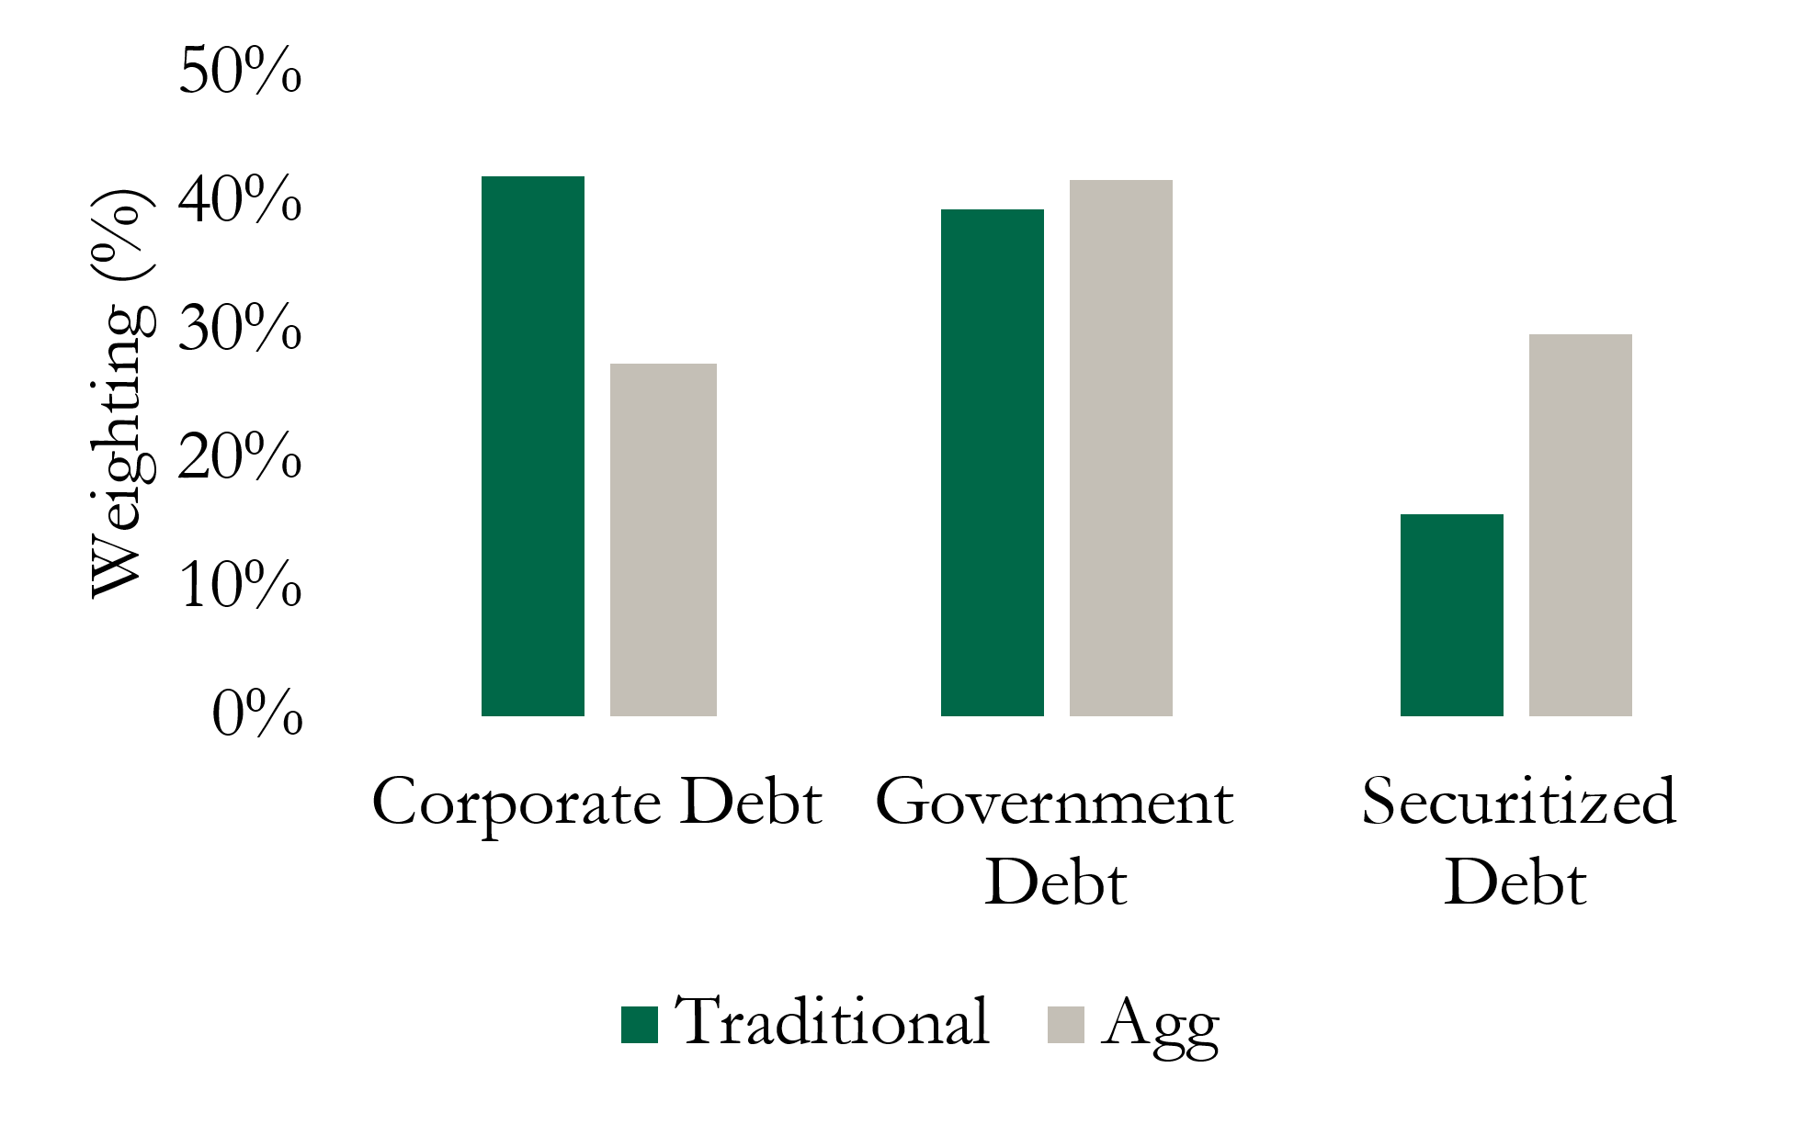
Market Outlook
Main Investment Theses
Moderate concerns regarding inflation
Underweight duration
Long corporate debt
Target high-rated names
Increase our MBS allocation
Portfolio Asset Allocation
Notes:
Have stat for what % we are underweight duration for alumni
Small but sizable, *net of Fees joke on outperformance by 3bps, most importantly better in terms of risk management perspective than we had during the COVID-induced liquidity crisis

Slide 8
Learning Points | Portfolio Management
08/30/2020 | ESG | Benchmark
Yield | 0.53 | 1.06
Duration | 5.20 | 6.11
Corporate | 20.3% | 28.8%
Government | 47.0% | 41.4%
Securitized | 6.2% | 29.2%
Focus on bond liquidity
Emphasis on risk-management
Duration Balancing
Cash Positions
Asset Allocation
Importance of Fed intervention
04/01/2021 | ESG | Benchmark
Yield | 1.27 | 1.47
Duration | 5.73 | 6.28
Corporate | 49.7% | 27.5%
Government | 40.3% | 41.7%
Securitized | 10.3% | 29.2%
Notes:
- Cash positions (can’t deploy 600K

Slide 9
Team Dynamics

Slide 10
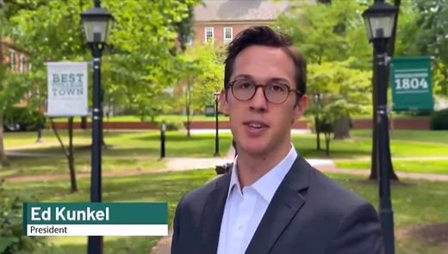
Fall & Spring Recruitment
- First ever virtual Finance Group Info Session
- Hosted by Fixed Income
- 90+ attendees
- Attained 8 new members (total fall/spring)
- Expand classroom presentation initiatives
- MIS & QBA
- Actuarial Science
- Computer Science
- 1-1 chats with 25+ prospective applicants
Recruitment Video
Notes:
- Talk about the diversity of the new members?

Slide 11
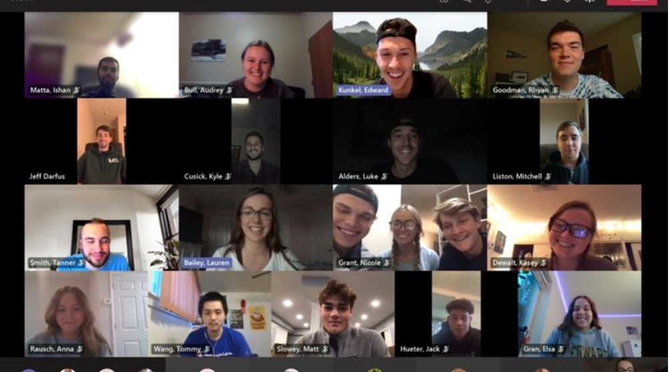
Maintaining Expectations & Culture
- Pre-pitch rationales
- Foster independent thinking & accountability
- Conference calls
- Bi-weekly calls with industry professionals/alum to discuss markets & careers
- 'Fabozzi' Book Club
- Promote continuous learning throughout winter term
- Invited alum to partake in discussions for various chapters
- Port discussions
- Ensure members are well versed in our positions
- Encourage students to formulate premediated market opinions
Call with Jeff Darfus
Notes:
20+ classes addressed, MIS, Business Analytics

Slide 12
Trainings & New Member Onboarding
- Zoom & Microsoft Teams
- BBG Anywhere
- Ensuring technical proficiency
- New Member trainings
- Diversifying Advanced Trainings
- Payments & Blockchain
- Agile Method
Behavioral Finance
Credit-Default Swap Training

Slide 13
Accomplishments
- 11+ internships secured for summer 2021
- First Computer Science major in 6 years
- Quantitative Strategies bi-weekly reports
- Monte Carlo simulations
- Blockchain exercises
- Bloomberg API
Portfolio 'firsts'
International Investment – Alibaba
Utilities Pitch – Duke Energy Indiana

Slide 14
Closing Remarks
Notes:
Thanks Sim.
Thankful for the opportunity
Thankful for the support of the faculty, the alumni (who continue to meet with us), and the
We are just extremely thankful for the opportunity to be able work studying these topics on a weekly to daily basis for some of us.
This is truly a life-changing opportunity for many of us,

