Slide 1
Individuals with Disabilities
Chapter 5
EDAD 6110
Mary Matney
Danielle Ramage

Slide 3
1975- Education for all Handicapped Children Act (EAHCA)
1990- Individuals with Disabilities Act (IDEA)
2004- Individuals with Disabilities Improvement Act (IDEIA)

Slide 4
Children with Disabilities as Defined by IDEA:
Mental retardation, hearing impairments including deafness, speech or language impairment, visual impairment including blindness, learning disabilities, brain injury, emotional disturbance, orthopedic impairments, autism, traumatic brain injury, specific learning disabilities, and other impairments who by reason of such conditions need special education and related services.
Essex, N. L. (2019). School law and the public schools: A practical guide for educational leaders. Upper Saddle River: Pearson.

Slide 5
IDEA/IDEIA Requirements:
Children 3-21 a free, appropriate public education (FAPE)
Substantive and procedural due process rights
State allocation of federal funds to
1.) serve children who are not receiving an education and
2.) children with most severe disabilities

Slide 6
-States must establish goals and formulate policies that ensure FAPE to students within its jurisdiction.
-Districts submit applications to states that demonstrate compliance with federal funds

Slide 7
National Council on Disability (NCD)
independent federal agency charged with advising the President, Congress, and other federal agencies regarding policies, programs, practices, and procedures that affect people with disabilities.

Slide 8
Special Education teachers must have possess at least a bachelor’s degree and earn a special education certificate.

Slide 9
Regular classroom teachers are responsible for identifying students who may benefit from special services.
-After working with student(s) a reasonable amount of time
- after continuous and multiple efforts have failed to meet the needs of students through regular classroom program
Districts create own referral policies and procedures

Slide 10
Response to Intervention (RTI)
-data-based process of diagnosing learning disabilities
-combination of assessments and interventions to support children who are having difficulty learning
-minimizes academic failure
-identifies appropriate interventions

Slide 11
RTI Continued…
Scientific, research based intervention strategies
Three tiered system
Tier 1: core instruction for all
Tier 2: intensive individualized instruction for students not exhibiting acceltable proficiency
Tier 3: intense instructional intervention to improve student progress

Slide 12
If formal testing is contemplated schools must receive parental consent
60 day timeline to evaluate
Fully objective evaluation free from bias
Evaluation occur in a timely fashion addressing each area of suspected disability

Slide 13
Alternate Assessment
-States have the option of testing up to 2% of their students using alternate assessments based on modified standards.
-Provisions affect roughly 30% of students.
Significant due to meeting AYP under NCLB

Slide 14
Individualized Education Program
IEP created for each student with disabilities
Should include:
Present level of performance
Annual goals
Description serviced to be rendered
Transitional services if junior or senior in high school
Timetable for services
Explanation of criteria to measure annual objectives
reviewed/revised annually

Slide 15
Least Restrictive Environment
Children with disabilities should be educated under normal classroom conditions with children who are not disabled
Relative concept- not same for each child
Placement options should be determined by needs of the child and the type of environment to best meet social and educational needs

Slide 16
Equal Access to
Assistive Technology for SWD
Technology-Related Assistance for Individuals with Disabilities Act Amendments (1994)- provides financial assistance to support systems changes that assist in the development and implementation of technology-related support for individuals with disabilities.

Slide 17
Personal Data Assistants for Disabled Students
Personal Data Assistant- versatile, personal computers that may be used for notes and serve as communication devices.
-PDAs are covered under the Technology-Related Assistance for Individuals with Disabilities Act.
-Considered “Related Services” that allow students to participate in regular classrooms consistent with their IEP.

Slide 18
Program Review & Changes
-IEPs must be reviewed annually to ensure the educational needs of the child are being met.
-Any changes require parent notification.
-If parents are dissatisfied with the changes, a hearing may be scheduled to resolve the issue.
-If the process is unsuccessful, parents may appeal the decision to the state agency and the court system.
--This process serves as a checks and balances and due process rights are being satisfied, as required by the ADA.
-If changes to an IEP are necessary after the annual review meeting, the LEA may agree not to meet at an IEP meeting to make the changes, but instead may develop a written document to amend the current IEP.

Slide 19
Burden of Proof
There is an ongoing problem between parents of disabled children and school districts regarding where the burden of proof lies in IEP court cases.
Schaffer v. Weast (2005) Supreme Court ruled that the burden of proof in a hearing challenging an IEP will now reside on the party seeking relief.
This decision has regulated the burden of proof in due process hearings.

Slide 20
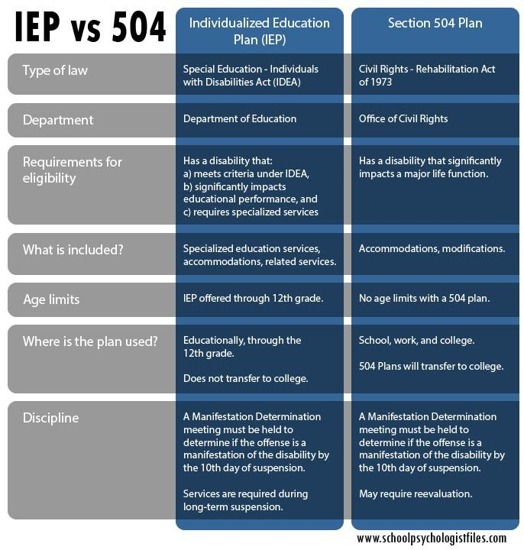

Slide 21
Section 504 RHA 1973
Students who qualify under section 504 are
provided an Individual Accommodation Plan (IAP)
IAP identifies the students disability (Physical or
Mental impairment that substantially limits one or
more major life activities), and the access to the school’s regular education program.
Some Examples of Major Life Activities:
-Caring for oneself
-Manual Tasks
-Sensory Activities
-Concentrating
-Communicating

Slide 22
The ADA Amendments Act of 2008
September 25, 2008- Amendments to the ADA were made to clarify and reiterate who is covered by the law’s civil rights protections.
Encompasses more impairments that substantially affect daily major life activities.
Clarified coverage of impairments that are episodic or in remission.
Some examples of such impairments: epilepsy, PTSD,
Amendments became effective January 1, 2009

Slide 23
Group Case Studies
Group #1 Student Disability & Inclusion Decisions (Pages 137-140) Tony Jessica Ashton Dr. Larson | Group #2 A Disabled Student & Related Services (Pages 135-137) Brandy Molly Michelle Nick Brittany
Group #3 SWD Reported to Law Enforcement (Pages 142-145) Amanda Dakota Codie Saretta Sam | Group #4 Isolation & Restraint (Pages 140-142) Amy Crystal Cory Dustin Angelica

Slide 24
Define the following acronyms:
IDEA- Individuals with Disabilities Education Act
RTI- Response to Intervention
IEP- Individual Education Program
FAPE- Free Appropriate Public Education
LRE- Least Restrictive Environment
2.) Eligible children with disabilities between the ages of three and twenty-one or until graduation are entitled to receive a free, appropriate education TRUE FALSE
3.) Regular classroom teachers have the responsibility to identify students who may need special services. TRUE FALSE
4.) Schools can evaluate students with or without parental consent? TRUE FALSE
5.) A student’s Individualized Education Plan (IEP) is reviewed and revised annually and reevaluated every 3 years.
6.) IDEA embraces children with disabilities being placed in educational settings that offer the least amount of restriction. Least restrictive environment is relative; what is LRE for one child may not be for another. Placement options should be determined based on the needs of the disabilities and the environment that will meet social and educational needs.

Slide 25
Congratulations! You just got schooled on IDEA :)

