Slide 1
Separation of church & state
By: Brandy bruce, samanta Howell, and Dakota taylor

Slide 2
Key amendments
1st Amendment= Congress shall make no law respecting an establishment of religion, or prohibiting the free exercise thereof; or abridging the freedom of speech, or of the press; or the right of the people peaceably to assemble, and to petition the Government for a redress of grievances.
14th Amendment= All persons born or naturalized in the United States and subject to the jurisdiction thereof, are citizens of the United States and of the State wherein they reside. No State shall make or enforce any law which shall abridge the privileges or immunities of citizens of the United States; nor shall any State deprive any person of life, liberty, or property, without due process of law; nor deny to any person within its jurisdiction the equal protection of the laws.

Slide 3
Establishment and Free exercise clauses
The Establishment Clause prohibits the state from passing laws that aid a religion or show preference for one religion over another.
The courts have used the Endorsement and Coercion Tests in some instances to gain a clearer interpretation of the Establishment Clause of the First Amendment.
The Free Exercise Clause prohibits the state from interfering with individual religious freedoms.

Slide 4
Lemon test
The famous Lemon Test decides the constitutionality of certain practices involving public and parochial schools. Based on the Lemon standards, it was determined that a law must meet the following criteria to be legally valid regarding religion:
Does it have a secular purpose?
Does it neither advance nor inhibit religion?
Does it not create excessive entanglement?
*****THE LEMON TEST is used to determine whether a law violates the Establishment Clause.
This Photo by Unknown Author is licensed under CC BY

Slide 5
Court Structure
*Supreme Court-Highest Court
*13 Appellate Courts- U.S. Court of Appeals
*94 U.S. District Courts

Slide 6
Religion in Schools
School Sponsored Prayer
School Sponsored Bible Reading
Silent Prayer and Meditation
Prayer at school events
Athletic events
Commencement
Board Meetings

Slide 7
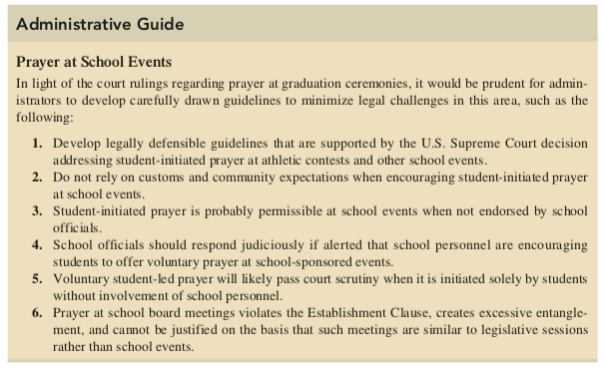

Slide 8
Equal access
ONE MINUTE
Do not allow some student clubs with ___________ non-curricular functions to meet on school premises while denying other religious clubs this same privilege, especially where there are ________ differences between the administration and school groups.
Avoid denying religious clubs access based on ________ or _____________ disagreement with the clubs’ objectives.
Do not establish extremely broad definitions as to what is considered curriculum related in an effort to _____ clubs.
Avoid classifying all other clubs as curriculum related irrespective of function and _________ the same classification for religious clubs.
School authorities should ______ the district’s legal council regarding any ______ religious activities in their school.
High school student religious clubs may be ______ to use school facilities if the school supports a limited open forum. They cannot be _____ use of other non curricular groups are permitted to use the facilities before or after the school day.

Slide 9
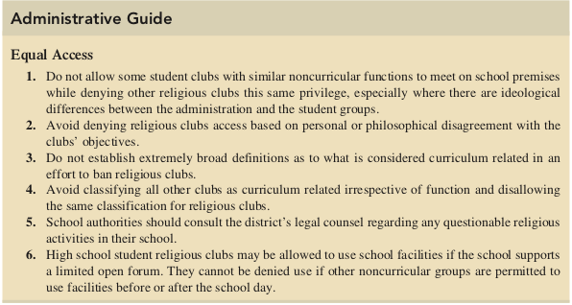

Slide 10
Outside religious groups
School districts _______ _________ religious groups access to their facilities if other nonreligious groups are permitted to use them.
School officials are ____ expected to allow religious groups to use facilities for regular religious services, even when an open forum is established by the district.
School districts are ____ required to _________ religious groups under a closed forum policy.
In the absence of religious services, school official ______ remain ________ ______ in permitting religious groups to use facilities under an open forum.

Slide 12
Religious Activities and Holiday Programs
The observance of Holy Days by public schools is against the constitution if conducted in a devotional atmosphere. Public Schools may not celebrate religious holidays. No worship, devotional services, religious pageants or plays should be held in any school.
School choirs and assemblies may be permitted as long as these activities are held for entertainment purposes rather than religious purposes.
The Merry Christmas Bill
The Texas legislature passed this bill in 2013, which protects Texas’s right to acknowledge traditional holidays on school grounds. It protects the schools from legal challenges while stressing that freedom of religion is not the same as freedom from religion.
This Photo by Unknown Author is licensed under CC BY-ND

Slide 13
Administrative guide: “Bible Teaching”
The Bible must be taught ___________________________________ and in a strictly secular manner.
Teachers should not create a ______________________________(religious) atmosphere when teaching the Bible.
Teachers assigned to teach the Bible as part of the school’s secular program must be _________________ ______________________ on how and what to teach.
School officials should formulate ______________________________ governing Bible teaching through the involvement of teachers, students, and, where appropriate, parents and community leaders.
Bible-teaching policies should be _____________________________ _________________________ to teachers, students, and parents.

Slide 14
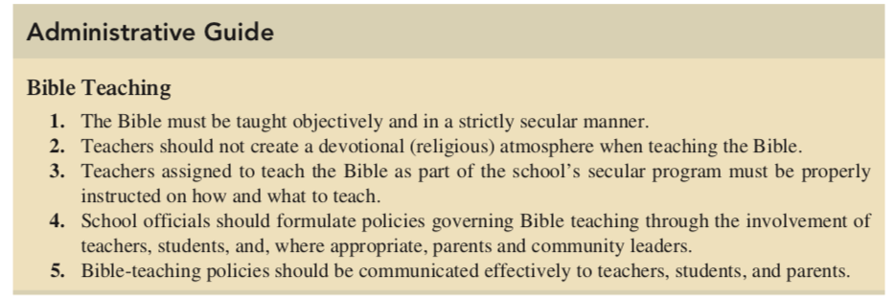

Slide 15
Administrative guide: “Intelligent design”
Advocates of intelligent design argue that it is not based on the Bible, is a __________________________ theory and should have equal status with other scientific theories. However, this view has not received significant support by the scientific community.
The theory of intelligent design suggests that certain features of the universe and of living things are best explained by an intelligent cause rather than a ______________________ _____________________.
Intelligent design asserts that physical and biological systems in the universe result from a purposeful design by an ____________________________ ________________ rather than from chance or undirected natural causes.
A district judge in Pennsylvania has ruled in Kitzmiller v. Dover that teaching intelligent design is unconstitutional because it carries ___________________________ ________________________________.
Unless ruled unconstitutional by a federal court in its jurisdiction, the decision regarding inclusion of intelligent design into the school’s curriculum is left to the discretion of __________________ ___________________ because the U.S. Supreme Court has not addressed its legality.

Slide 16
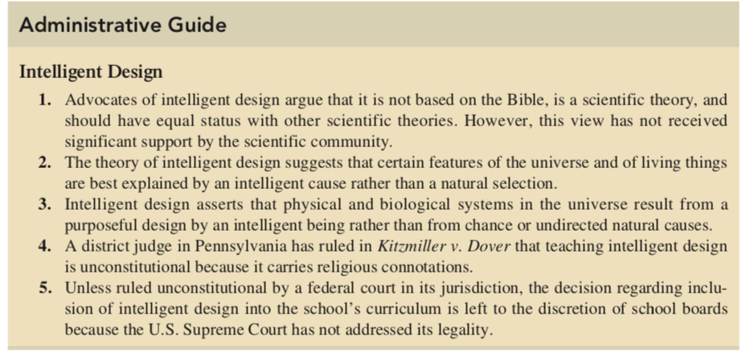

Slide 17
Administrative guide: “Theory of Evolution”
The Theory of Evolution suggests that all life is related and has descended from a common ancestor.
Historically, evolution theory had been ___________________________from public school curriculum based on a view that it conflicted with the biblical version of creation.
The U.S. Supreme Court, however, in Epperson prevented lawmakers from banning the teaching of evolution in public schools, holding that evolution is a ______________________ rather than a secular religion.
Biological evolution is considered to be a _____________ based on historical evidence by biologists.
The prevailing debate among biologists revolves around details of _____________evolution occurred rather than whether it occurred.
The evolution theory provokes _____________________between the scientific community and certain evangelical and fundamentalist Christian religious groups based on their attempts to prevent the teaching of evolution by having it replaced with teaching from their religious traditions.
The decision regarding the inclusion of evolution theory is left to the discretion of the __________________ ___________________.

Slide 18
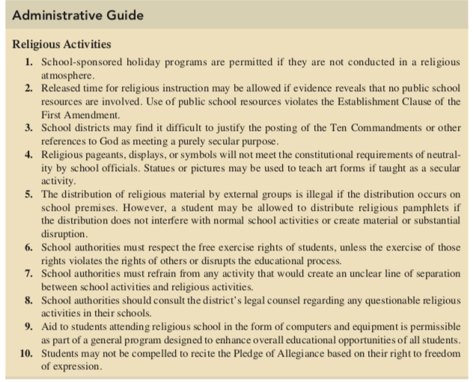

Slide 19
POST TEST
5 minutes…

Slide 20
Anticipation Guide Answers… 1-5= ALL TRUE
School-sponsored prayer is illegal and cannot be justified based on First Amendment prohibitions.
School-sponsored Bible reading in public is an illegal activity. However, the bible may be used as an instructional document to meet a secular purpose.
Silent meditation or any other type of devotional activity sanctioned by schools will not be supported by the courts.
Invocations at school sponsored athletic activities violate the establishment clause of the First Amendment.
Private voluntary prayer by a student is permissible under the free exercise clause of the First Amendment.

Slide 21
True or false?
The Bible may be used constitutionally as an appropriate study of history, civilization, ethics, or comparative religion. = TRUE
Public school officials also may not allow religious groups to distribute religious materials on school grounds. =TRUE
The principle of neutrality demands that schools assume a neutral position, neither supporting religion nor prohibiting individual students from exercising their religious rights. =TRUE
The pledge is unconstitutional when recited in public schools. = FALSE!
The words under God in the Pledge of Allegiance does not violate the separation of church and state. =TRUE

Slide 22
Pre/Post Test I-v: Answers=
I. The 14th Amendment makes the 1st Amendment applicable on a state level. However, the uncertainty of whether religious rights were implied in the Constitution was sufficient to justify the need for a Bill of Rights protecting religious freedoms. Noticeable among these rights was the separation of church and state, which guarantees religious freedoms and prohibits the establishment of religion by the government. The Fourteenth Amendment made the First Amendment applicable to state action, thus providing the same constitutional guarantees to citizens against state infringement of their religious rights by prohibiting the establishment of religious practices in public schools.
II. Establishment Clause and Free Exercise Clause
III. It must have a secular purpose. It must neither advance nor inhibit religion. It must not create excessive entanglement.
IV. On June 14, 2004, the U.S. Supreme Court overturned the Ninth Circuit Court’s decision on technical grounds and preserved the contested phrase “one nation under God” in the Pledge of Allegiance. The Supreme Court ruled that Newdow, the plaintiff, had no legal standing to challenge the pledge because he was not the custodial parent of his then ten-year-old daughter and could not legally represent her. This ruling failed to address whether the inclusion of the reference to God was an impermissible practice involving an unconstitutional blending of church and state.
V. By policy or practice, school officials may permit public groups to use school facilities during non-instructional hours as long as their activities do not interfere with normal school operations. Districts are not required to provide facilities to community groups.

Slide 23
Works Cited
Essex, Nathan L., author. School law and the public schools : a practical guide for educational leaders / Nathan L. Essex, University of Memphis.—Sixth edition.
Administrative Office of the U.S. Courts: Accessed from web June 14, 2019, https://www.uscourts.gov/about-federal-courts/court-role-and-structure

