Slide 1
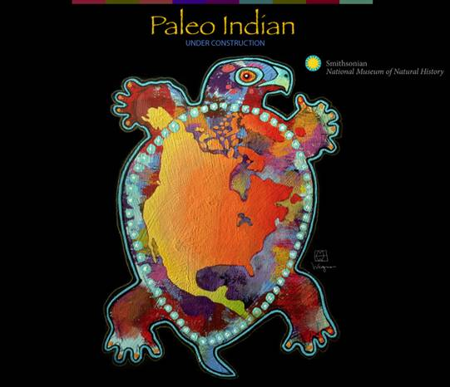
PALEOINDIAN 11,500 – 8000 B.C.
13,500 – 10,000 B.P.

