Slide 1
Chapter 4/10
Please sign in up front :)

Slide 2
President
Yay for our initiated pledges!
Help me plan a fundraiser/charity event :) Paper Chapter next week for Easter!
Molly Sanders
president.aphiodeltagamma@gmail.com | 937-216-0964

Slide 3
Leadership
Heyyy!
You only need 1 leadership hour !!
simon_sinek_why_good_leaders_make_you_feel_safe
Rowan Andrews
(937)-404-8105
leadership.aphiodeltagamma@gmail.com

Slide 4
Service
Food Bank-Every other Saturday
Raking
Charity Miles
E-cards
Herb Garden- April 13th-14th @10am
Erin Smith
service.aphiodeltagamma@gmail.com
(937)314-1242

Slide 5
Fellowship
-iMessage Games
-Spotify Playlist
- remember you need 3 hours this semester !! :)
Emily Cingle
Email: fellowship.aphiodeltagamma@gmail.com
Phone: (330) 760-4246

Slide 6
Treasurer
Dues are $55 please pay or let me know if you can’t if you have not paid yet!!
Vanessa Evans
(614) 361-7801
treasurer.aphiodeltagamma@gmail.com

Slide 7
Sergeant at Arms
Hey bros!
Vote on Historian: Sophia Starkie

Slide 8
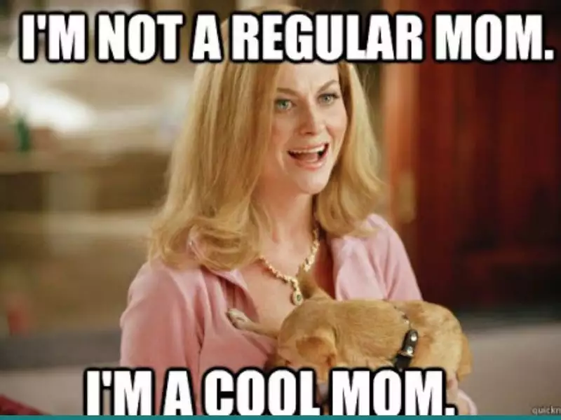
Ombudsman
Hope your mom's weekend was unforgettable
As for merch:
Prices are the same (I can send them in the groupme)
Venmo me by Tuesday/Wednesday at the latest!!
Hopefully will have them ordered by thursday or friday
As for hat: working with Molly on ways to get it
Emma Boyer
254-368-7760
ombudsmen.aphiodeltagamma@gmail.com

Slide 9
Membership/Pledge Ed
-Happy Initiation!
-Bigs be looking out for little’s request for fellowship and service event!
Maddy Myles
(740) 503-7143

Slide 10
Communication
Attendance will be up to date after chapter!
Please reach out to me with any attendance issues or any ideas for the Instagram :)
Send me any pictures from events you do!
Don’t forget to follow our social medias for pics/updates this semester!
Pledge TikTok: pledgeaphio
Twitter: @APhiODeltaGamma
Instagram: APhiO_DeltaGamma
Courtney Batten
937-621-1487
communications.aphiodeltagamma@gmail.com

Slide 11
Historian
Happy can!
Graduation cords are in
Elizabeth Fote
(937) 204-4842 Historian.deltagammaaphio@gmail.com

Slide 12
Toast Song
Here's to Alpha Phi Omega, Loyal Brothers we,
True to self and to each other, firm in loyalty.
Daily working, daily striving, ever more to be
True to Alpha Phi Omega, Our Fraternity.
Brothers clasp the hands of Brothers,
strong the circle we
Ever mindful, ever serving all humanity.
Now we raise our grateful
voices in our song to thee:
True to Alpha Phi Omega, may we always be.

