Slide 1
Chapter 3/20
Sign in up front !!!

Slide 2
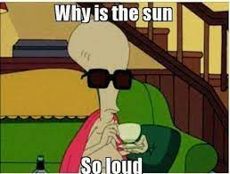
President
HOW IS EVERYONE FEELING ?!?
Vote for Voting Delegates: Courtney Batten and Rowan Andrews
Any community chapter advisor ideas?
Meet with me to talk about hours/anything :)
Molly Sanders
president.aphiodeltagamma@gmail.com | 937-216-0964

Slide 3
Leadership
Heyyy!
You only need 1 leadership hour !!
simon_sinek_why_good_leaders_make_you_feel_safe
Rowan Andrews
(937)-404-8105
leadership.aphiodeltagamma@gmail.com

Slide 4
Service
Hey guys,
Last opportunities for donations
Raking
Food Bank- Every other Saturday
Charity Miles
Erin Smith
service.aphiodeltagamma@gmail.com
(937) 314-1242

Slide 5
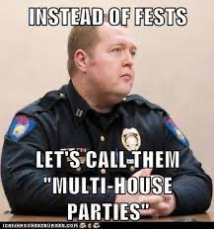
Fellowship
Happy Fest Season!
-iMessage Games
-Spotify Playlist
-Dinner sometime this week? (I’ll send a poll in the groupme)
Emily Cingle
Email: fellowship.aphiodeltagamma@gmail.com
Phone: (330)760-4246

Slide 6
Treasurer
DUES ARE $55
DUE MARCH 27th, If you need any help please let me know!
Vanessa Evans
(614)361-7801
treasurer.aphiodeltagamma@gmail.com

Slide 7
Sergeant at Arms
Hi everyone!
Nominations for historian!
Cameron Carter
saa.aphiodeltagamma@gmail.com
(937) 903-5768

Slide 8
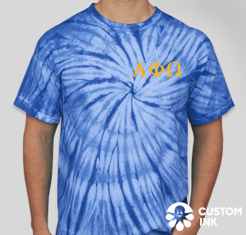
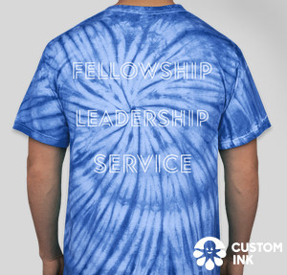
Ombudsman
Hi!! Here are some merch ideas I came up with! Let me know what you think!
Not sure of pricing yet; I believe I need to get a headcount of who all wants what
Emma Boyer
(254)368-7760
ombudsmen.apiodeltagamma@gmail.com

Slide 9
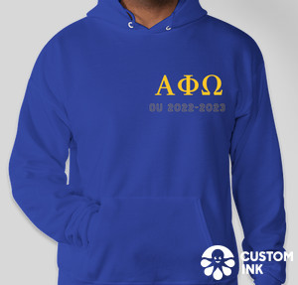
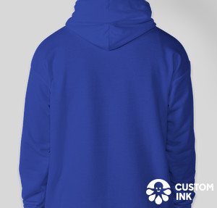
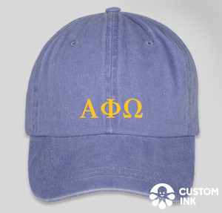

Slide 10
Membership/Pledge Ed
-Big/Little Reveal next week before chapter!
-more details to come by Friday
-if you would like to be a big send in application by Tuesday night!
Maddy Myles
pledgeducators.aphiodeltagamma@gmail.com
(740) 503-7143

Slide 11
Communications
Attendance will be up to date after chapter!
Please reach out to me with any attendance issues or any ideas for the Instagram :)
Send me any pictures from events you do!
Don’t forget to follow our social medias for pics/updates this semester!
Pledge TikTok: pledgeaphio
Twitter: @APhiODeltaGamma
Instagram: APhiO_DeltaGamma
Courtney Batten
937-621-1487
communications.aphiodeltagamma@gmail.com

Slide 12
Historian
Happy Can!
Elizabeth Fote
(937) 204-4842
Historian.deltagammaaphio@gmail.com

Slide 13
Toast Song
Here's to Alpha Phi Omega, Loyal Brothers we,
True to self and to each other, firm in loyalty.
Daily working, daily striving, ever more to be
True to Alpha Phi Omega, Our Fraternity.
Brothers clasp the hands of Brothers,
strong the circle we
Ever mindful, ever serving all humanity.
Now we raise our grateful
voices in our song to thee:
True to Alpha Phi Omega, may we always be.

